Slide 1

The Job Search

Slide 2
Effective Resume Style
Best font types are Times New Roman and Arial
readable and professional looking
Avoid designer and cursive fonts
Use a 10- to 12-point font for your text
Headings can be boldface and 14- to 16-point font size.
Limit your resume to no more than two font types: one for headings and one for text.

Slide 3
Effective Resume Style
Avoid Sentences
repetitious and egocentric
risk of committing grammatical errors
take up room in your resume
Format Your Resume for Reader-Friendly Ease of Access
Highlight your resume with easily accessible lists
Set apart your achievements by bulletizing your accomplishments, awards, unique skills, and so on
Highlight by boldfacing headings and indenting subheadings to create white space
Avoid underlining headings or italicizing text (hard to read)

Slide 4
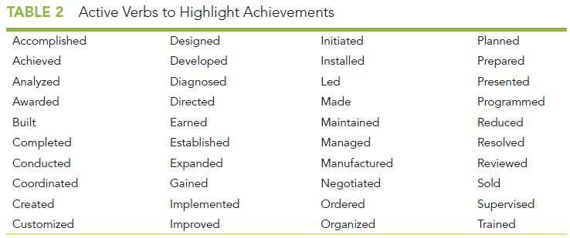
Effective Resume Style
Begin Your Lists with Verbs
To convey a positive, assertive tone, use verbs when describing your achievements
Use present tense verbs for current jobs and education
Use past tense verbs for past jobs and education
Quantify Your Achievements
Make It Perfect
It is your first impression

Slide 5
Types of Resumes
Reverse Chronological Resume
Functional Resume
Are a traditional job applicant (a recent high-school or college graduate, aged 18 to 25)
Hope to enter the profession in which you have received college training or certification
Have made steady progress in one profession (promotions or salary increases)
Plan to stay in your present profession
Are a nontraditional job applicant (returning to the workforce after a lengthy absence, older, or not a recent high-school or college graduate)
Plan to enter a profession in which you have not received formal college training or certification
Have changed jobs frequently
Plan to enter a new profession

Slide 6
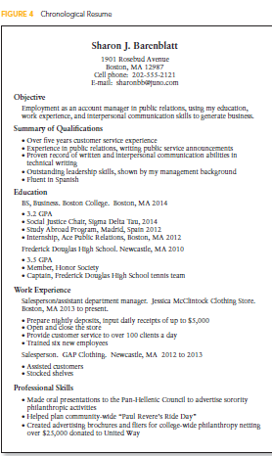
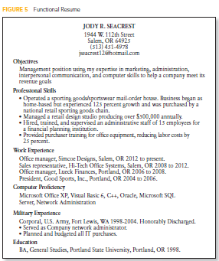

Slide 7
Criteria for Effective E-mail Cover Messages or Letters of Application
Mandatory components: your address, the date, your reader’s address, a salutation, the letter’s body, a complimentary close, your signed name, your typed name, and an enclosure notation if applicable.
Introduction
Tell where you discovered the job opening. You might write, “In response to your advertisement in CareerBuilder . . .” or “Bob Ward, manager of human resources, informed me that . . . .”
State which specific job you are applying for. Often, a company will advertise several jobs. You must clarify which of those jobs you’re interested in. For example, you could write, “Your advertisement for a computer maintenance technician is just what I have been looking for.”
Sum up your best credentials. “My BS in chemistry and five years of experience working in a hazardous materials lab qualify me for the position.”

Slide 8

Criteria for Effective E-mail Cover Messages or Letters of Application
Discussion. In the discussion paragraph(s), sell your skills.
State that you’ve attached a resume for the e-mail message or enclosed a hardcopy resume with the letter.
Focus on your assets uniquely applicable to the advertised position. Select only those skills from your resume that relate to the advertisement and will benefit the prospective employer.
Don’t explain how the job will make you happy: “I will benefit from this job because it will teach me valuable skills.” Instead, using the pronouns you and your, show reader benefit: “My work with governmental agencies has provided me a wide variety of skills from which your company will benefit.”
Quantify your abilities. Don’t just say you’re great (“I have outstanding customer service skills and communication abilities”). Instead, prove your assertions with quantifiable facts: “I won the 2012 Employee of the Year for providing solutions to customer concerns and working well with teammates.”

Slide 9
Criteria for Effective E-mail Cover Messages or Letters of Application
Conclusion-a call to action
“I am looking forward to discussing my application with you in greater detail. Then I can explain ways I could benefit your company.”

Slide 10
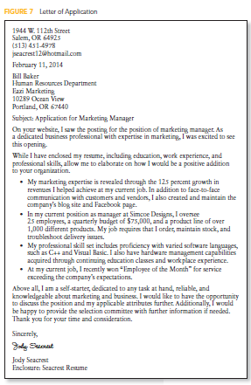

Slide 11
Online Application Etiquette
Do not use your current employer’s e-mail system.
Avoid unprofessional e-mail addresses.
Send one e-mail at a time to one prospective employer.
Include a clear subject line.
Tell the reader how you have saved the attached resume.

